Slide 1

Why Oreos Are Bad
By Dayshelay Evans
This Photo by Unknown author is licensed under CC BY-NC-ND.

Slide 2

What's so bad about an oreo?
One of the essential, if not the most important, ingredients is palm oil.

Slide 3
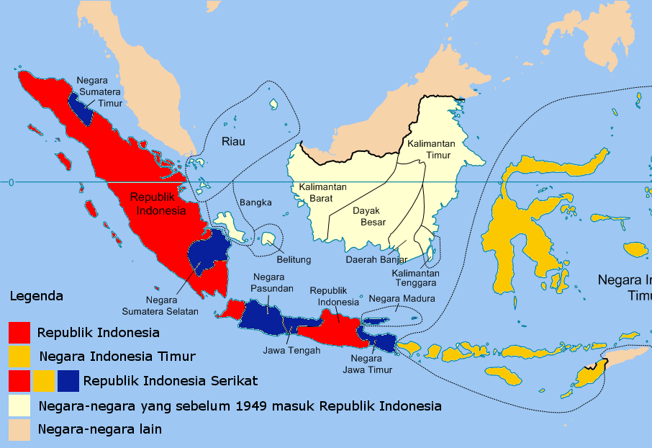
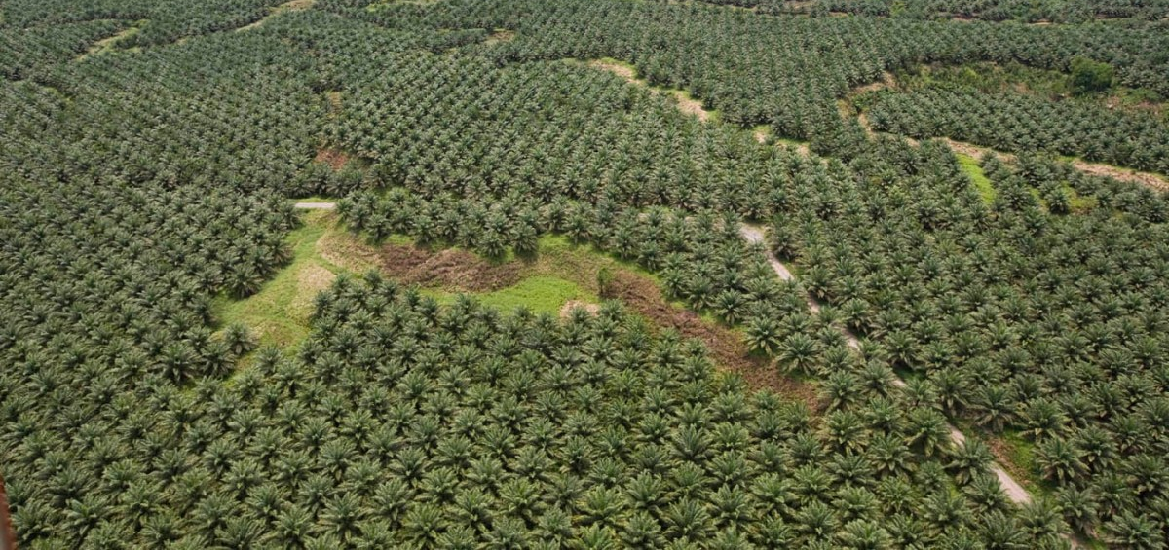
The Palm Oil Industry
As of 2006, Indonesia is designated as the largest producer of crude palm oil on the planet
Palm oil plants contribute to a monoculture that is unable to act as a substitute for typical diverse ecosystem
This Photo by Unknown author is licensed under CC BY-NC.
This Photo by Unknown author is licensed under CC BY-SA.

Slide 4
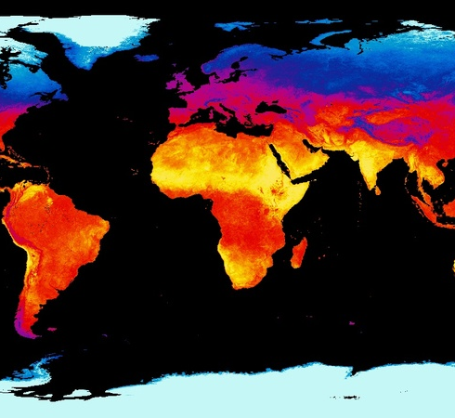
Tropical Nations are Sensitive
Global land use changes are responsible for approximately 14% of greenhouse gases in the atmosphere
The tropics would face the greatest climatological impact
Nations located in the tropics are designated as having significantly less wealth than their first-world counterparts, which is attributed to the functioning of economic systems
This Photo by Unknown author is licensed under CC BY.

Slide 5
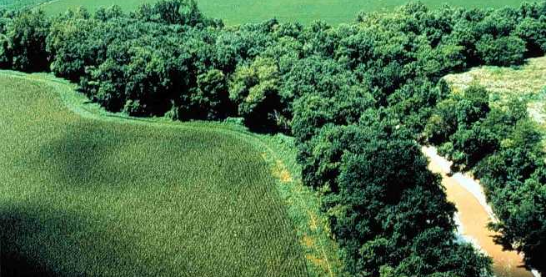
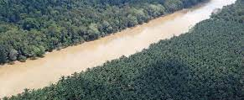
Disrupting the Existing Environment
Lost riparian buffers, leading to erosion
Differing levels in carbon fixation
The palm oil industry is often introduced to developing countries as a means of bolstering the economy
A 2012 study indicated that migrant workers held more palm oil plots, and therefore more opportunity for financial gain, than the local population
This Photo by Unknown author is licensed under CC BY-SA.

Slide 6
Research Question
How does the conversion of tropical land and subsequent management of palm oil plantations contribute to global warming and climate change?

Slide 7
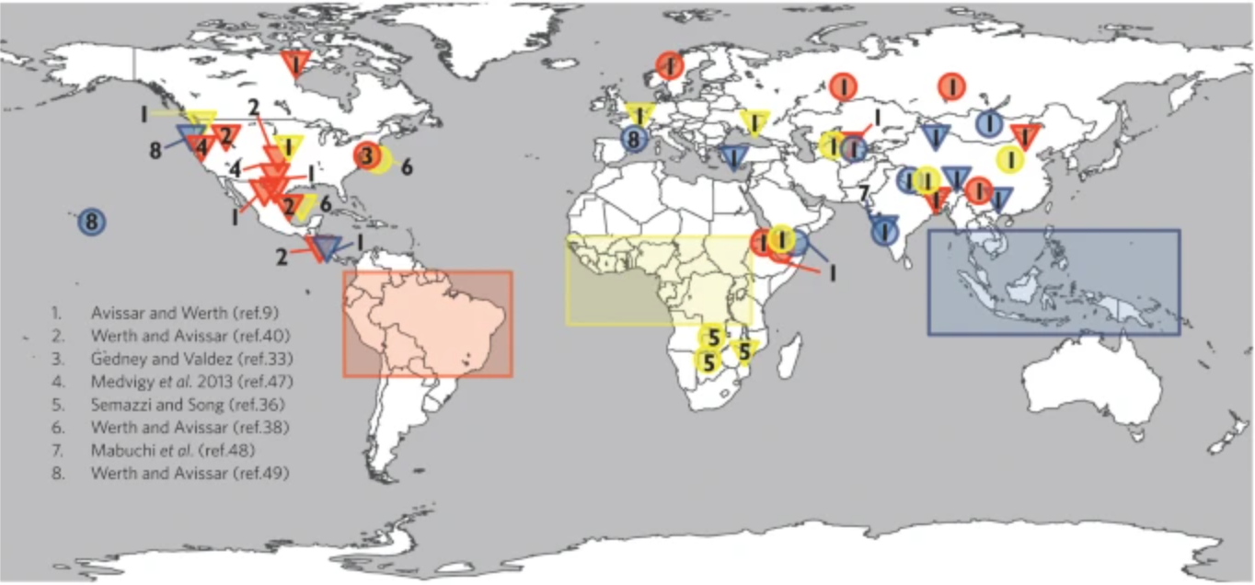
Research Method 1
General Circulation Models
3D computer model of the global climate system
General circulation models simulate the potential climactic consequences of deforestation on the regional scale
Notes:
Circular marks are an indicator of increasing precipitation.
Triangles are an indicator of decreasing precipitation.
Red values are representative of areas that resulted from complete deforestation in the Amazon.
Yellow values are representative of areas that resulted from complete deforestation in Africa.
Blue values are representative of values resulting from complete deforestation in Southeast Asia.
Data was compiled from several sources and organized by corresponding numerical values. (Andersson, et al., 2018)
The first study utilizes data from general circulation models to understand the relationship between land surface and climate
A general circulation model is a 3D computer model of the global climate system that portray a connection between the atmosphere, bodies of water, and land coverage
Latitudinal and longitudinal data play a crucial role as these models rely heavily on grids, which often range from 1-5 degrees in either respect
General circulation models simulate the potential climactic consequences of deforestation on the regional scale in the respective areas of the Amazon basin, Central Africa, and Southeast Asia as well as the consequences presented by both pantropical and global deforestation
The researchers state that an intercomparison project would be helpful to increase the scientific community’s understanding of how various occurrences and the models themselves contribute to, exacerbate or mitigate the changes produced by deforestation

Slide 8
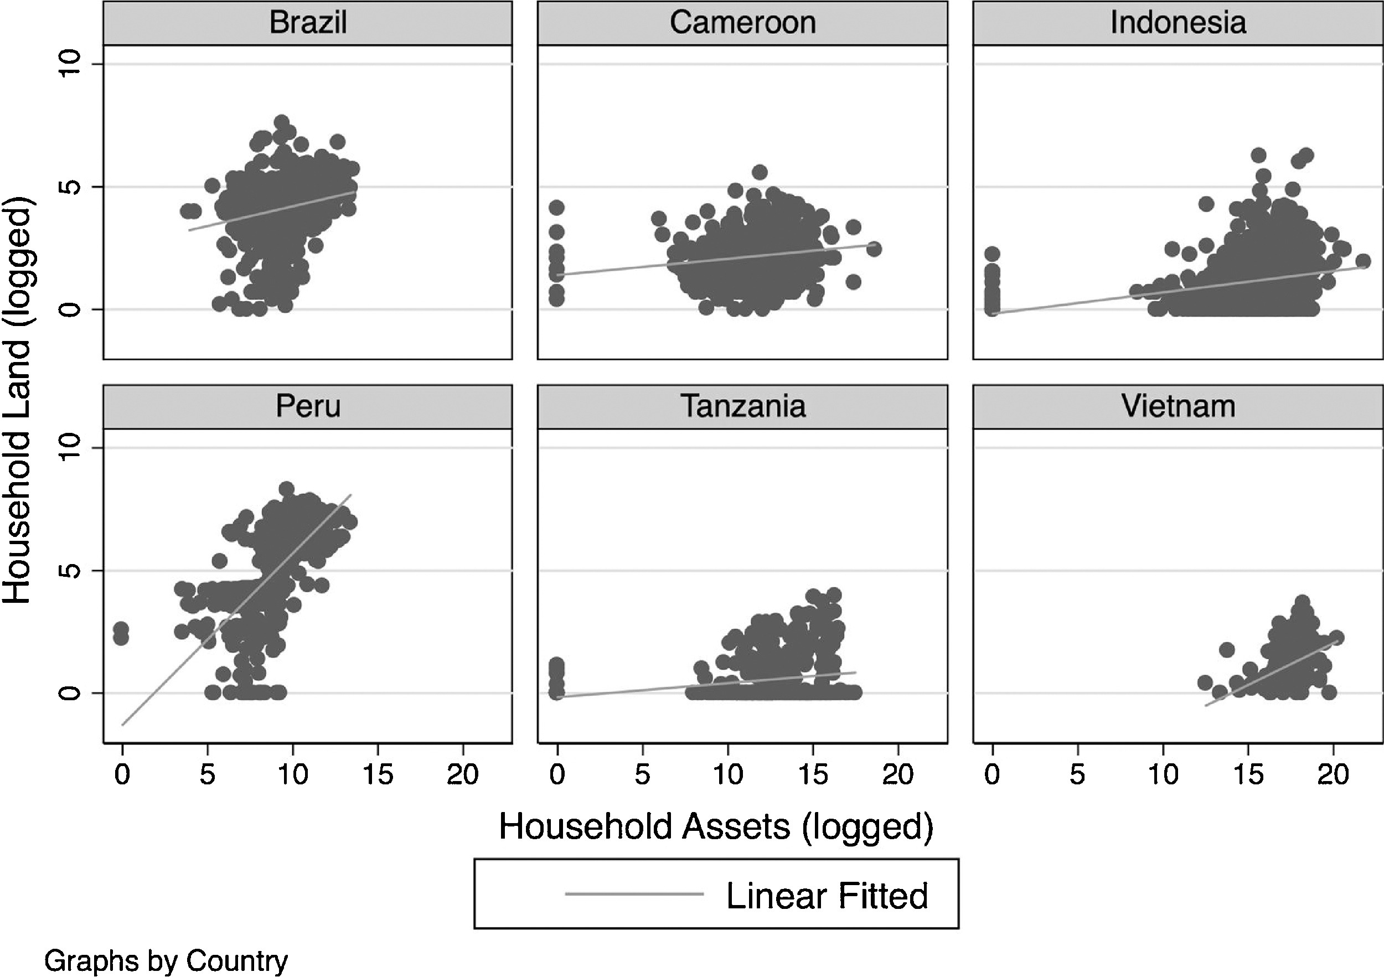
Research Method 2
Algorithm
Goal was to predict the future distribution of forest benefits
Regression analysis was used to analyze data

Slide 9
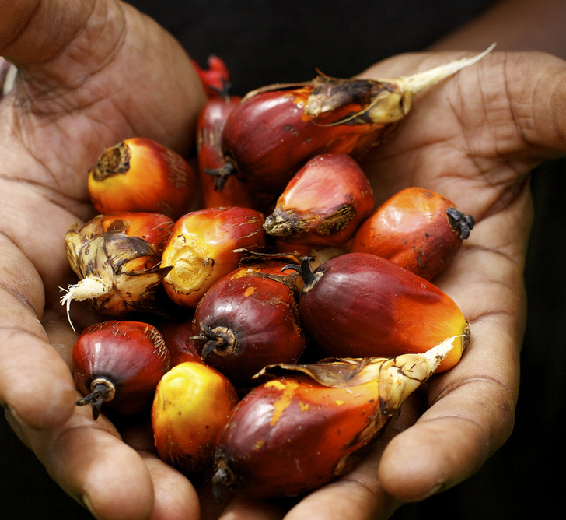
Gaps in the Literature
How does palm oil production relate to carbon production?
What feasible alternatives are there both in the sense of product and strengthening the tropical economy?
This Photo by Unknown author is licensed under CC BY-ND.
Notes:
Remember to bring up solutions

Slide 10
Works Cited
Andersson, K. P., Smith, S. M., Alston, L., Duchelle, A., Mwangi, E., Larson, A., . . . Wong, G. (2018). Wealth and the distribution of benefits from tropical forests: Implications for REDD+. Land Use Policy, 72, 510-522. doi:https://doi.org/10.1016/j.landusepol.2018.01.012.
Ayompe, L. M., Schaafsma, M., & Egoh, B. N. (2021). Towards sustainable palm oil production: The positive and negative impacts on ecosystem services and human wellbeing. Journal of Cleaner Production, 278. doi:https://doi.org/10.1016/j.jclepro.2020.123914
Blumenau, J. (2021). The Effects of Female Leadership on Women's Voice in Political Debate. British Journal of Political Science, 51(2), 750-751. doi:10.1017/S0007123419000334.
Budidarsono S, D. S. (2012). Socioeconomic Impact Assessment of Palm Oil Production. Bogor, Indonesia: World Agroforestry Centre. Retrieved from http://apps.worldagroforestry.org/sea/Publications/files/policybrief/PB0049-12.pdf
Bullough, A., & Sully de Luque, M. (2014). Women’s participation in entrepreneurial and political leadership: The importance of culturally endorsed implicit leadership theories. Leadership, 11(1), 36-56. doi:https://doi.org/10.1177%2F1742715013504427
Cerri C, S. G. (2007). Tropical Agriculture and Global Warming Impacts and Mitigation Options. Sci. agric, 64(1), 83-99. doi:https://doi.org/10.1590/S0103-90162007000100013
Girdaukiene, L., & Eyvazzade, F. (2015). The Profile of an Effective Female Leadership in Multicultural Context. Procedia - Social and Behavioral Sciences, 210, 11-20. doi:https://doi.org/10.1016/j.sbspro.2015.11.323.
Hsiang, S. M., & Meng, K. C. (2015). Tropical Economics. American Economic Review, 105(5), 257-261. doi:http://dx.doi.org/10.1257/aer.p20151030
Krishna, V., Euler, M., Siregar, H., & Quaim, M. (2017). Differential livelihood impacts of palm oil expansion in Indonesia. Agricultural Economics, 48(5), 639-653. doi:https://doi.org/10.1111/agec.12363
Lawrence, D., & Vandecar, K. (2015). Effects of tropical deforestation on climate and agriculture. Nature Climate Change, 5, 27-36. doi:https://doi.org/10.1038/nclimate2430
Michaelowa, A., & Michaelowa, K. (2015, October 21). Do rapidly developing countries take up new responsibilities for climate change mitigation? Climactic Change, 133, 499-510. doi:https://doi.org/10.1007/s10584-015-1528-6
Shimamoto CY, P. A. (2018). Restoration of ecosystem services in tropical forests: A global meta-analysis. PLoS ONE. doi:https://doi.org/10.1371/journal.pone.0208523
Szymanska, I., & Rubin, B. (2018). Gender and relationship differences in the perceptions of male and female leadership. Gender in Management, 33(4), 254-281. doi:https://doi.org/10.1108/GM-06-2016-0127
Wittmer, D. E., & Bouche, V. (2018). The Limits of Gendered: Policy Implications of Female Leadership on "Women's Issues". Politics and Gender, 9, 245-275. Retrieved from https://vanessabouche.com/wp-content/uploads/2015/06/WittmerBouche2013.pdf

